Slide 1

Advanced Text Summarization
An overview of our text summarization tool, its capabilities, and how it works.

Slide 2
Core Functionality
Our tool offers multiple summarization methods:
Abstractive Summarization
Utilizes advanced transformer models (BART, T5, Pegasus) to generate concise summaries.
Extractive Summarization
Employs LSA to extract key sentences from the text.

Slide 3
Model Selection
Choose from a variety of state-of-the-art summarization models:
BART
facebook/bart-large-cnn
T5 Small
t5-small
Pegasus
google/pegasus-xsum
DistilBART
sshleifer/distilbart-cnn-12-6

Slide 4
Customization Options
Tailor the summarization process to your needs:
Summary Length
Adjust minimum and maximum lengths for desired output.
Reference Summary
Provide a reference for ROUGE score evaluation.
Extractive vs. Abstractive
Select your preferred summarization method.

Slide 5
Performance Metrics
Evaluate the quality of the generated summaries:
ROUGE-1 Score
Measures overlap of unigrams between generated and reference summaries.
ROUGE-L Score
Measures overlap of the longest common subsequence.
Readability Score
Assesses the ease of understanding the summary (Flesch Reading Ease).

Slide 6
Visual Insights
Gain a quick understanding of the summary's key themes:
Word Cloud
Visually represents the most frequent words in the summary.

Slide 7
File Handling
Effortlessly process documents:
File Upload
Supports TXT, PDF, and DOCX formats.
Text Extraction
Automatically extracts text from uploaded files.
Download Summary
Save the generated summary as a .txt file.

Slide 8
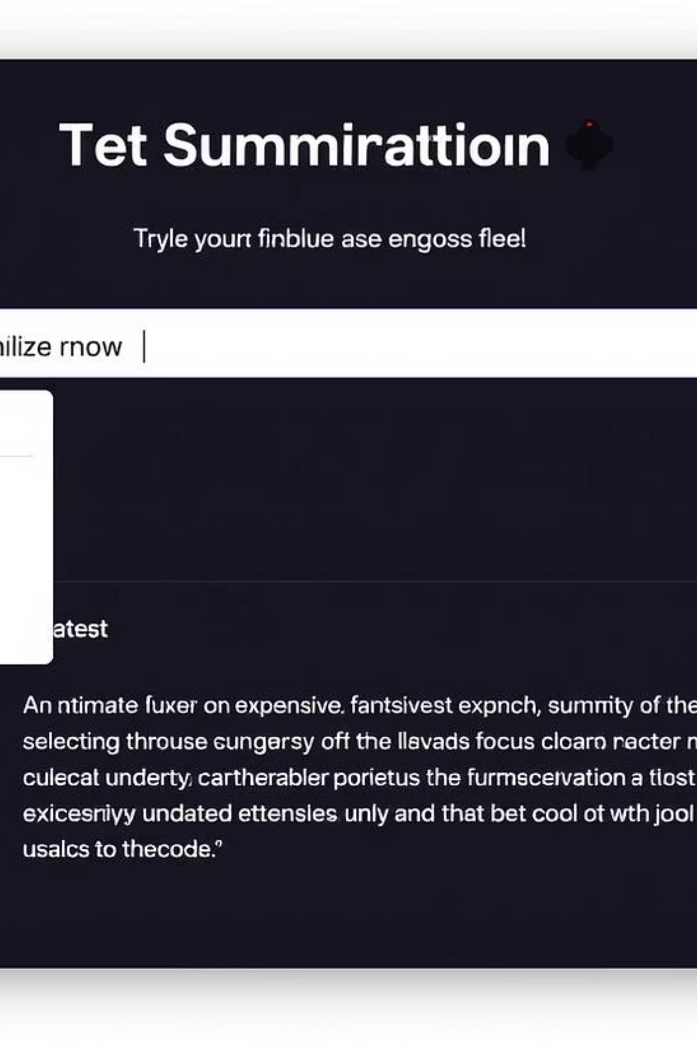

Interactive Demo
Experience the text summarizer firsthand.

